Slide 1


Slide 2

House-Passed Reconciliation Bill: Overview
Permanently extends some of the key 2017 tax provisions
Advances some of President Trump's campaign pledges
Increases funding for defense and border security priorities
Reduces domestic spending (more later)
Debt Limit Increase

Slide 3
House-Passed Reconciliation Bill: Tax Provisions of Concern
Limiting itemized deduction
Taxation of parking and transit benefits (UBIT)
Private foundation tax increase
Foundations with assets below $50 million: 1.39%
Foundations with assets between $50 million and $250 million: 2.78%
Foundations with assets between $250 million and $5 billion: 5%
Foundations with assets above $5 billion: 10%
1% AGI floor for corporate charitable giving

Slide 4
House-Passed Reconciliation Bill: Spending Cuts
Medicaid Cuts
SNAP Cuts
Student Loan Overhaul

Slide 5


Slide 6

Take Action!
Sign a National Letter by June 2
Urge Congress to remove harmful provisions in the tax bill targeting nonprofit organizations and share the letter with your networks!
2. Contact Your Senators
Urge Congress to protect nonprofits and their ability to serve their communities in the tax package.

Slide 7
Topline Message: Don't harm the people who rely on nonprofits to pay for tax cuts.
Ultimately, the people in your community who rely on the services provided by nonprofits will be most harmed. Focus on those who won't be able to access food banks, crisis hotlines, drug recovery programs, and more.
Nonprofits will have to cut back on services to the community, or close their doors. Most nonprofits (59%) have budgets less than $50K, and 92% have budgets less than $1M, and cannot absorb these cuts.
Rural and suburban communities will be impacted the most. Most nonprofits (66%) are located in rural and suburban communities and show up every day to serve their neighbors.

Slide 8
Critical Targets – Republicans!
Ask your Republican Senators to protect the nonprofit sector and the millions of people who rely on their services.
Crapo (R-ID)
Hawley (R-MO)
Lankford (R-OK)
McCormick (R-PA)
McConnell (R-KY)
Murkowski (R-AK)
Thune (R-SD)
Tillis (R-NC)
Young (R-IN)
Barrasso (R-WY)
Blackburn (R-TN)
Boozman (R-AR)
Capito (R-WV)
Cassidy (R-LA)
Collins (R-ME)
Cotton (R-AR)
Cornyn (R-TX)

Slide 9
What about Democrats?
Yes, you should contact them too!

Slide 10
Legislative Process and Outlook
Senate timing, likelihood of committee markups
Scope of changes
House action
Debt limit wildcard

Slide 11


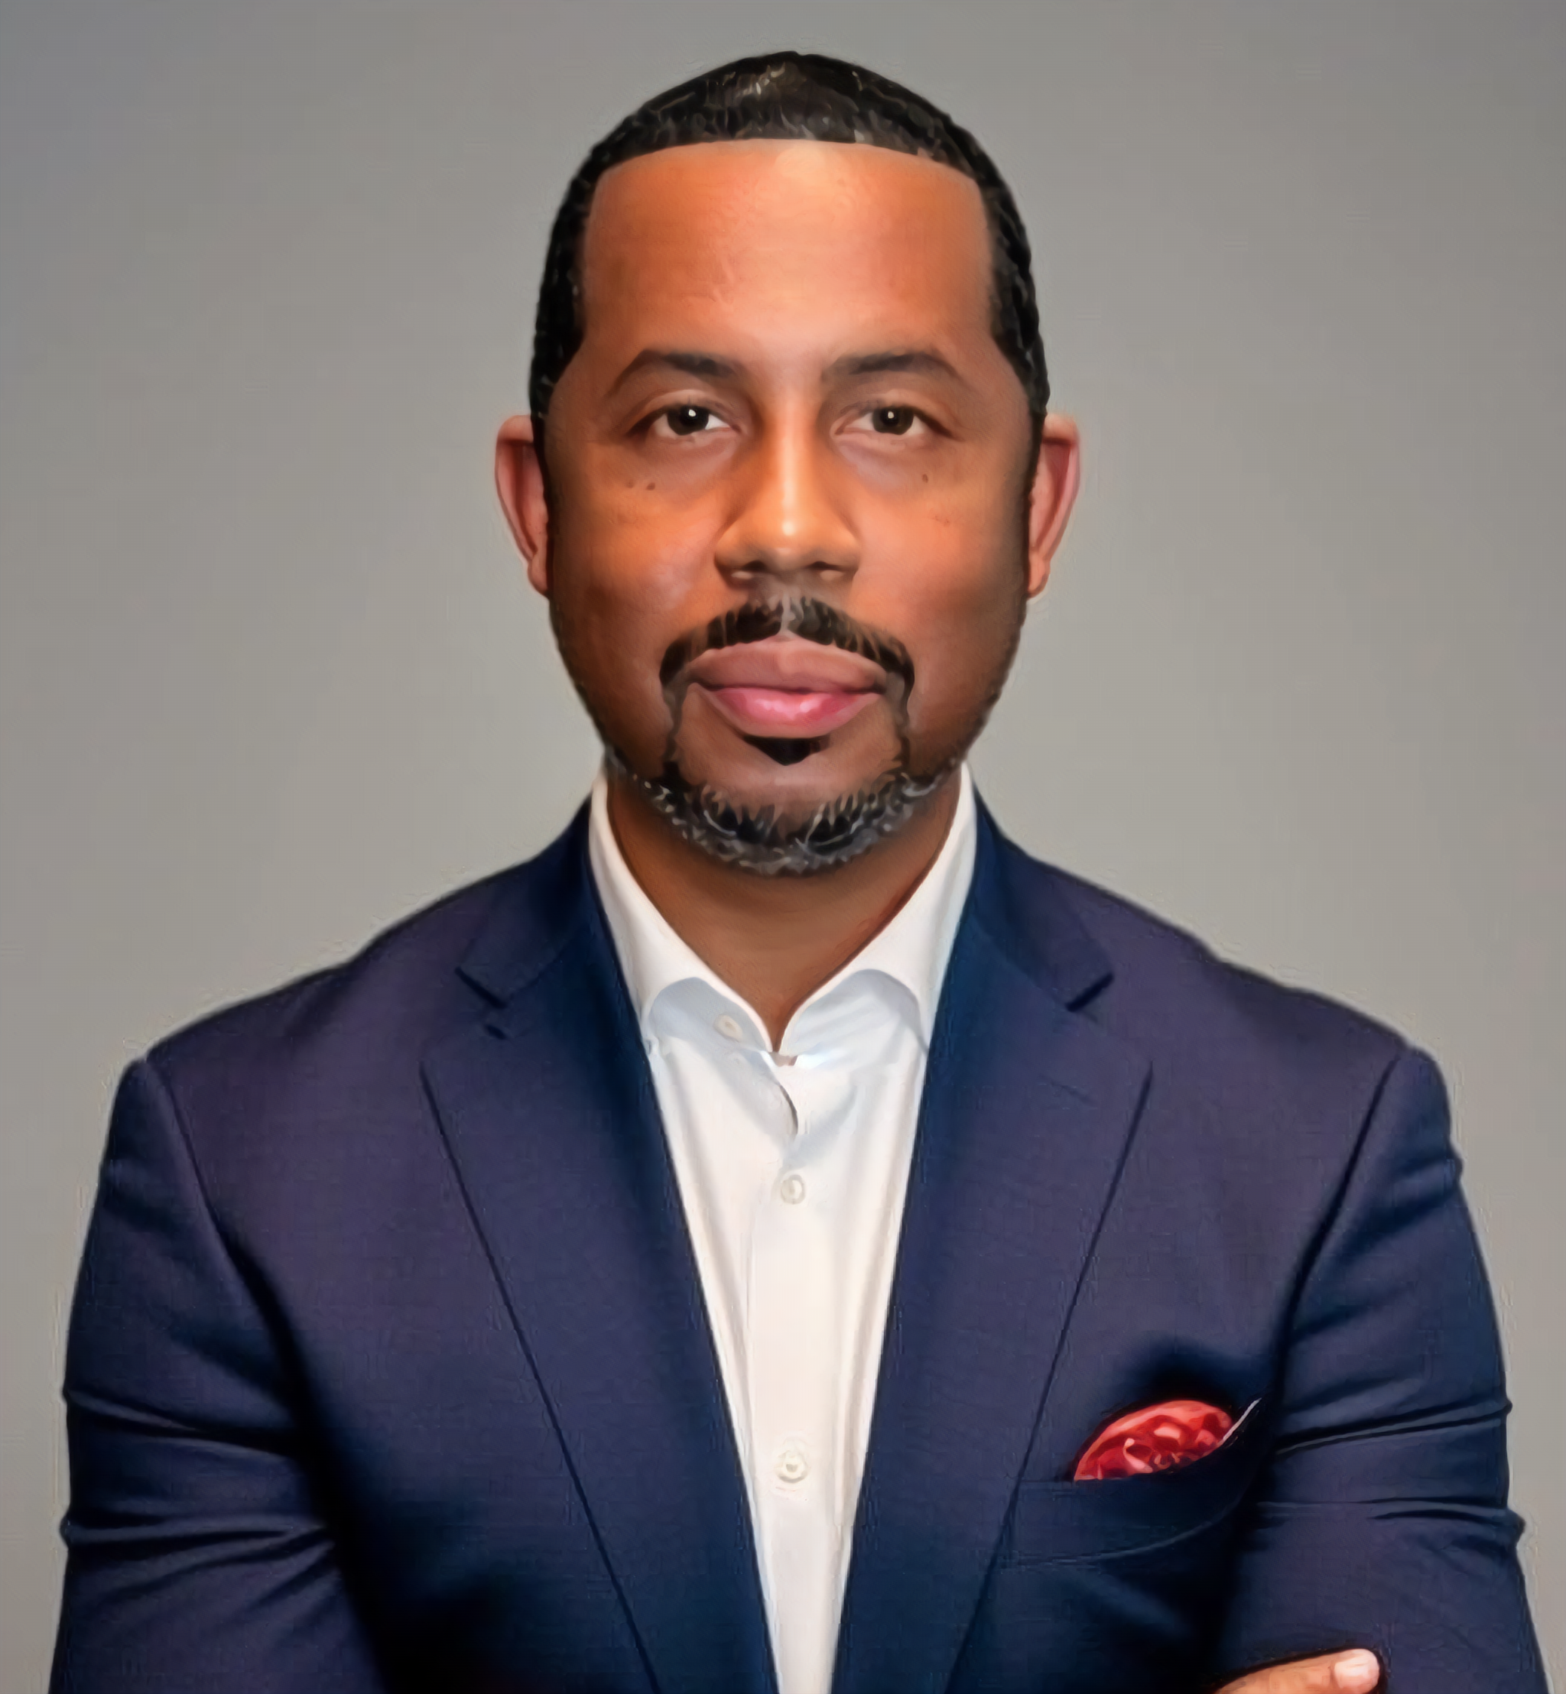

Reach Out To Us
Ben Kershaw
benk@independentsector.org
Jenn Holcomb
jenn.holcomb@cof.org
Matthew L. Evans
matthew@unitedphilforum.org
Sarah Saadian
ssaadian@councilofnonprofits.org

Slide 13


