Slide 1
We envision a world of engaged individuals, robust institutions, and vibrant communities working together to improve lives and the natural world and strengthen democratic societies.

Slide 2
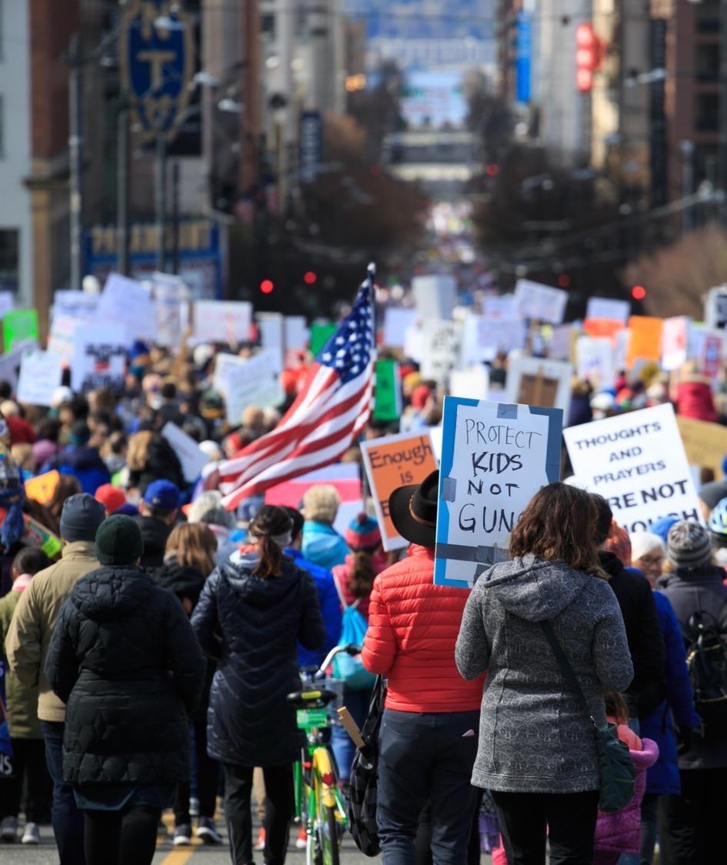

The middle class is shrinking
We worry that our children won’t enjoy the quality of life we have today
A Sense
of Unease
The “American Dream”
is an illusion
We feel we have lost control
Wealth gap is widest on record
Distrust not just in politics but in democracy

Slide 3
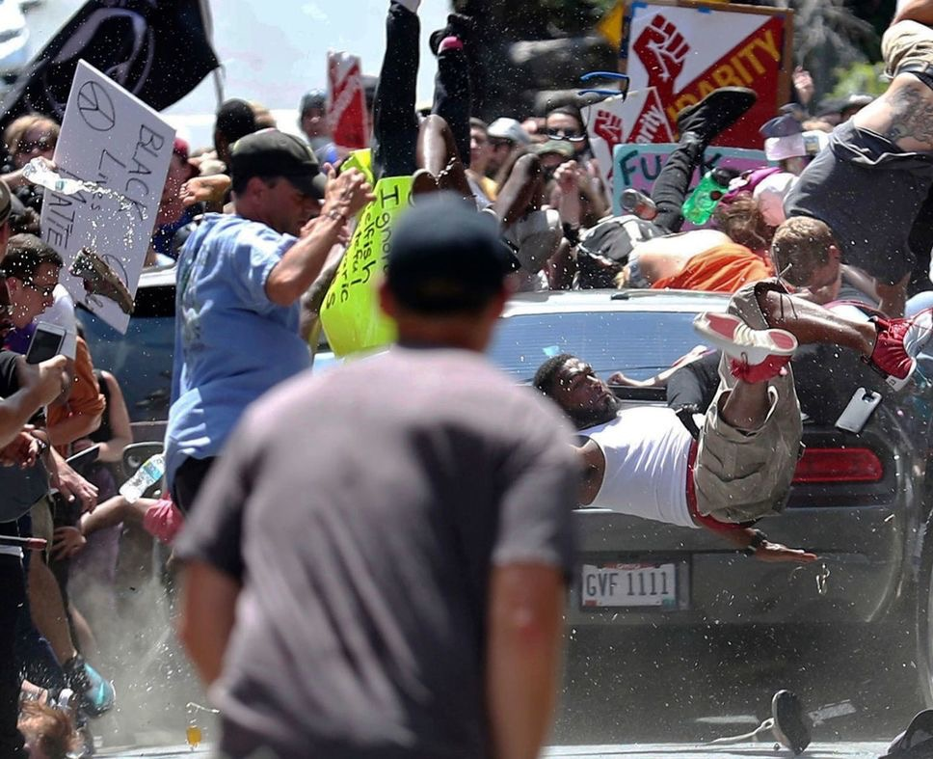
In times of doubt, uncertainty and wrenching social change, civil society is more important than ever. But civil society cannot thrive unless it is trusted, effective and deeply engaged with as many stakeholders as possible.

Slide 4
The State of Trust
Trust in NGOs drops.
For the first time, trust in NGOs has fallen to nearly the same level as trust in businesses. In the GDP 5—the U.S., China, Japan, Germany, and the U.K.—trust in NGOs fell below 50 percent.
 | 2012 | 2013 | 2014 | 2015 | 2016 | 2017 | 2018
Govt | 32% | 38% | 32% | 35% | 39% | 47% | 33%
Media | 37% | 38% | 35% | 39% | 47% | 47% | 42%
Business | 44% | 50% | 48% | 51% | 51% | 58% | 48%
NGOs | 49% | 52% | 52% | 52% | 57% | 58% | 49%
TRUST INDEX | 40 | 45 | 42 | 44 | 49 | 52 | 43
Source: Edelman Trust Barometer

Slide 5
America Without Nonprofits
What happens?
5

Slide 6


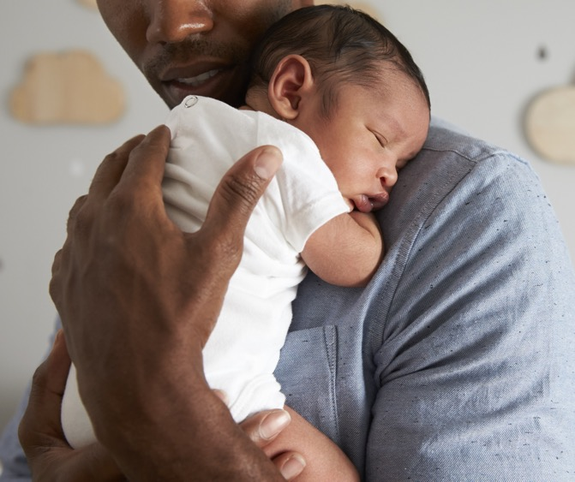
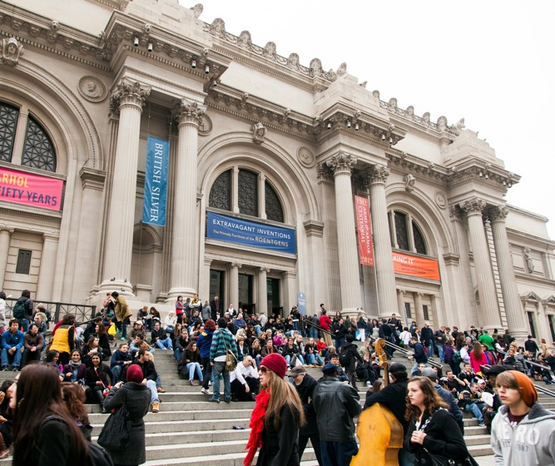
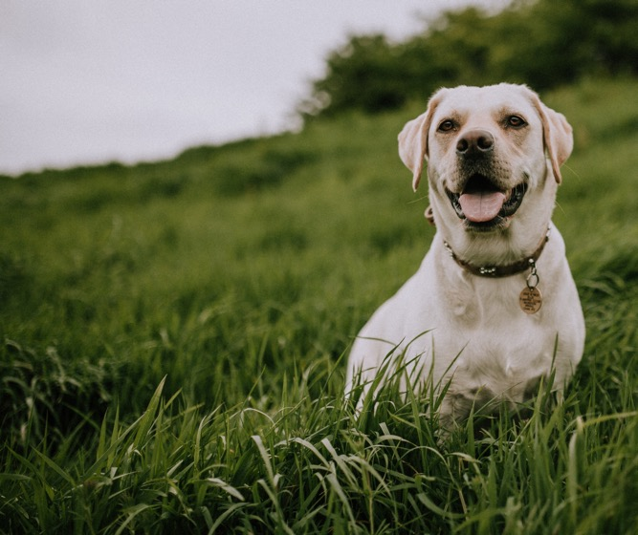

Afterschool programs for millions of kids
Shelters for those fleeing domestic violence
Nutritious food, diapers and immunizations for millions of infants
Museums that showcase art,
culture and history
Rescue or adoption programs for animals
Rehabilitation services for those with disabilities
6

Slide 7
A Force to Be Reckoned With
14 Million Employees
63 Million Volunteers
5.4% of
US GDP
3rd largest employer in America
Valued at $25 per hour
$634 billion
In payroll
7

Slide 8

Independent Sector’s Unique Role
8

Slide 9
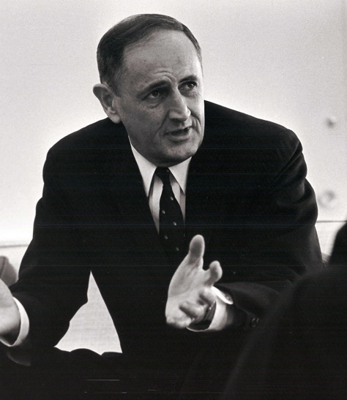
John W. Gardner, along with nonprofit, foundation, and corporate leaders, founded IS
in 1980 in recognition of the need for:
A strong public policy voice
for the sector
Increased communication
and information sharing among leaders
World-class resources to support effective organizations.
“We are continually faced with a series of great opportunities brilliantly disguised as insoluble problems.”
John W. Gardner
9

Slide 10
An Accelerator for Civil Society
Build
Community
Accelerate
Impact
Lead
on Policy
10

Slide 11
Build Community
For nearly 40 years, Independent Sector has represented the only sector-spanning community of nonprofits, foundations and corporate giving programs.
Independent Sector (IS) is the nonpartisan leadership network for nonprofits, foundations, and corporations advancing
the common good.
From the biggest foundations to local charities, with staffs from 35,000 to 2, our membership consists of nonprofits, foundations, and corporations engaged in every kind of charitable endeavor.
We are the “vital meeting ground”
for America’s change-makers and
problem-solvers.
By bringing together the best minds and the biggest hearts we help communities and organizations do better at doing good.
11

Slide 12
Accelerate Impact
Working in collaboration with others, we create, curate, and disseminate knowledge designed to help organizations respond to challenges and opportunities, increase their effectiveness, and fulfill their missions.
Ethics & Accountability
Diversity, Equity & Inclusion
Leadership
Technology for Social Good
Sector Impact Data & Sector Narrative
Platform for Co-Creation & Collaboration
12

Slide 13
Lead on Policy
Sole voice of the combined charitable and philanthropic sector, we play a proactive, solutions-driven role to craft and defend policies that advance the common good and promote the health of the sector.
Charitable Giving
Tax & Fiscal Policy
Nonprofit Operations
Lobbying & Political Activity
13

Slide 14
What’s Next?
14

Slide 15
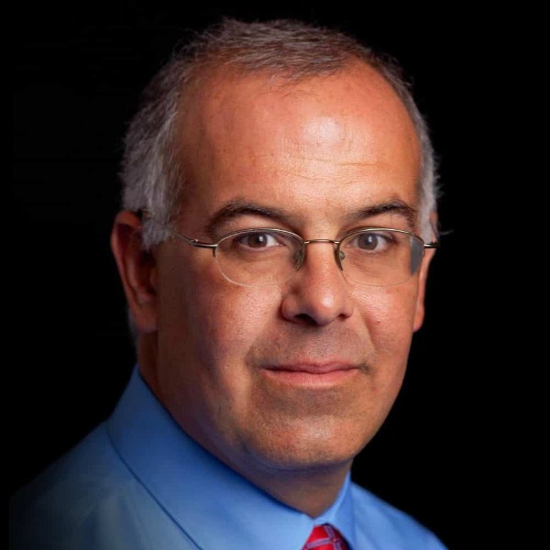
If the early 2000s were defined by the Silicon Valley hackers, and the 1980s were defined by the Yuppies, and the 1960s were defined by the hippies, I believe the coming years will be defined by some of the people in this sector, who are living most urgently to build a new social fabric, who are working most urgently to build a new power dynamic, and who are thus addressing the central problem of our time.
DAVID BROOKS
New York Times
Op-Ed Columnist
15

Slide 16
By strengthening the heart of civil society – some 1.5 million nonprofit and philanthropic organizations in every state and community – Independent Sector has a unique role to play at this crucial point in time.
We believe that no other organization is better positioned or prepared to accelerate change across nonprofits, foundations and corporate giving programs.
16

Slide 17
Good Must Grow.
Nonprofits Must Stay.
Social Good Landscape
Government & Public Institutions
Traditional Nonprofit
Social Entrepreneurs
Corporations
17

Slide 18
Build Community
In-Person
Engagement
Audience
Building
Virtual
Engagement
18

Slide 19
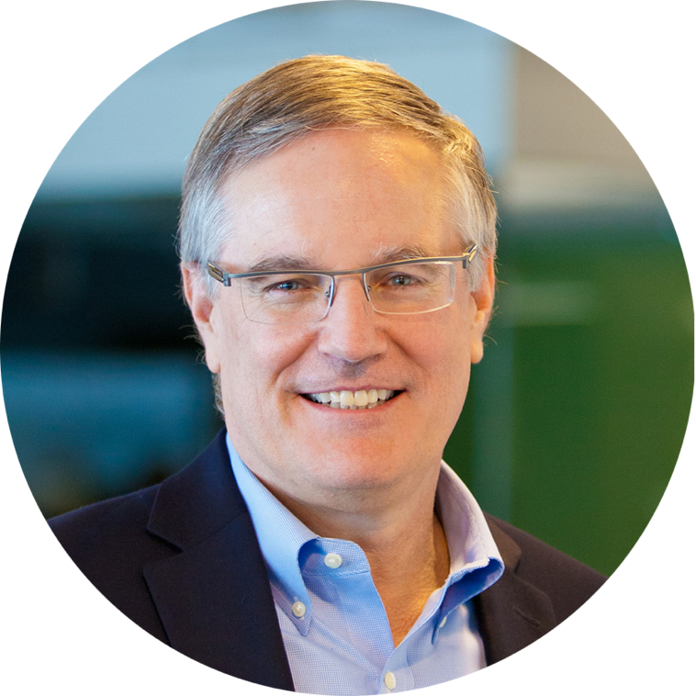
One of America’s most defining characteristics is how private individuals organize to advance their vision of public good. The vitality of America—and of our democracy—depends on that powerful, cacophonous, independent energy. Bridgespan has been a member of Independent Sector for the last 20 years because none of what we do would be possible without a strong independent sector.
JEFF BRADACH
IS Board Chair and Co-Founder, The Bridgespan Group
19

Slide 20






A Vision to Grow, Support, Connect, and Engage
20

Slide 21


21

Slide 22
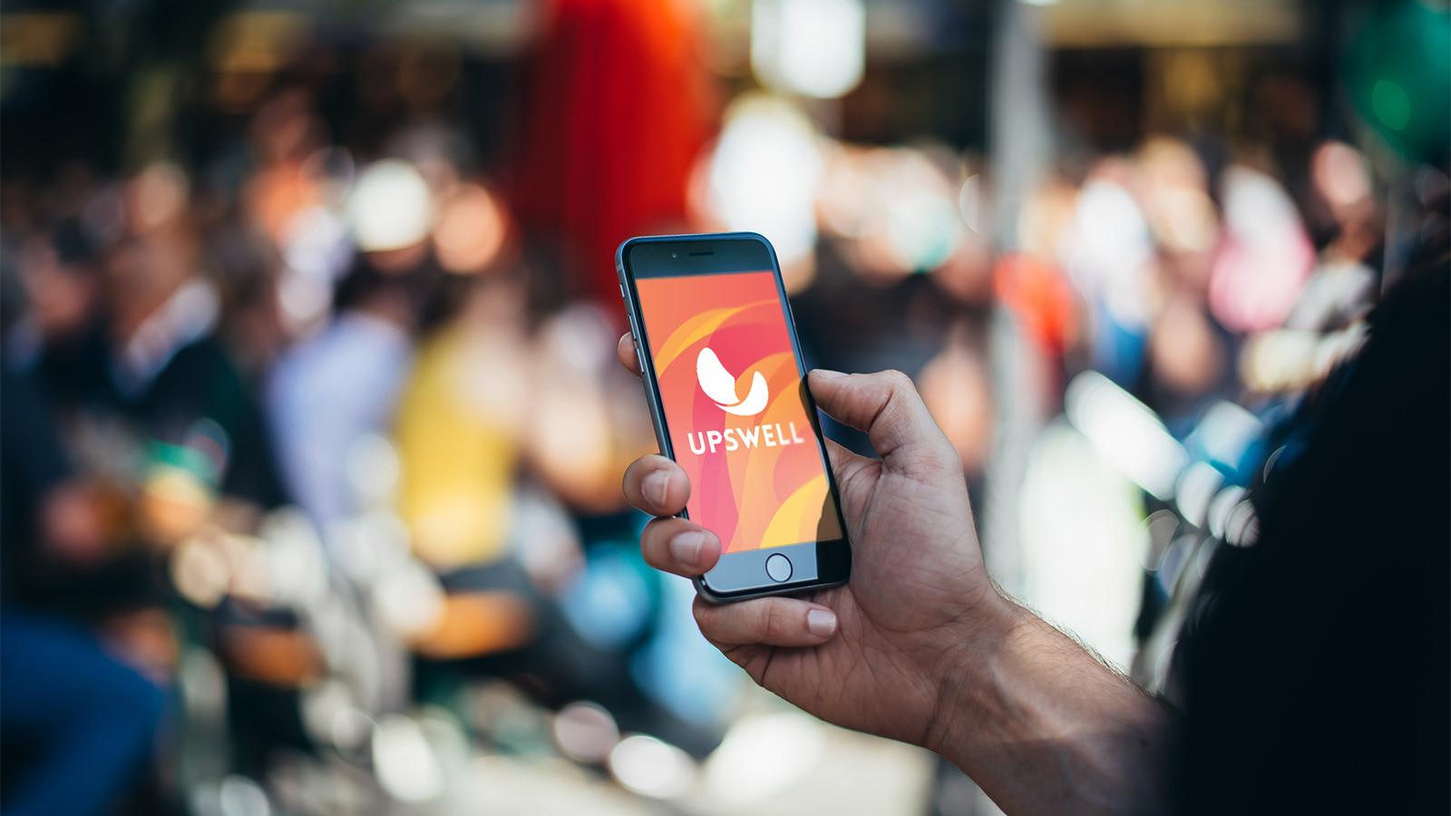
22

Slide 23


Independent Sector Vision
We envision a world of engaged individuals, robust institutions, and vibrant communities working together to improve lives and the natural world and strengthen democratic societies.
23

Slide 24
About Upswell
What is Upswell?
Changemakers today face mounting challenges –
but not insurmountable. When we join together as purpose-driven professionals, we can rise to any challenge. And that’s what Upswell is about.
Upswell is an immersive, high-energy forum for turning ideas into action. Forge new partnerships, address big challenges, exchange lessons learned, and explore best practices for advancing your mission.
We are rising to meet the challenge together.
Who's it for?
If you’re working to change the world for the better, then Upswell is for you. It’s that simple.
Nonprofit professionals and social entrepreneurs, community leaders and corporate citizens – changemakers are as diverse as the problems we’re trying to solve. Every perspective gets us closer to new solutions. Social collisions can yield powerful and unexpected results.
Your ideas and experiences make you unique.
Will you join us?
24

Slide 25

Public Square
There's something exhilarating about entering a new space and being overwhelmed with opportunity.
What do you do first: plug into a virtual reality experience, jump into a brainstorming challenge, or search for a moment of zen in a meditation group? In the Public Square, you can explore it all. (And so much more.)
If Upswell is about creating a better world together, then the Public Square is the place to dive into the nearly infinite ways of doing so. It’s where creativity, innovation, science, spirituality, and strategy collide.
The Public Square is designed to accommodate all kinds of ideas and activities. We envision it evolving year after year. In LA, it will feature the Main Stage events, a huge VR arcade, dozens of exhibitors, a bookstore, creative networking spaces, brainstorming challenges, rapid prototyping activities, meditation, 10-minute pitch sessions, issue-based focus groups, gourmet cafes, and even lawn games.
25

Slide 26

Workshops
Upswell is for changemakers, but what are you trying to change? The world, of course. But that’s a pretty tall order.
What if you could spend 60 to 90 minutes changing yourself – your outlook, knowledge base, skill set, toolbox, or network? Could you leverage those changes in pursuit of your world-changing mission?
That’s what Upswell workshops are all about. They offer a change-making environment for personal experimentation, growth, and connection – rewarding curiosity about what can be. They provide an interactive venue for honing or acquiring new skills, and a wide variety of ways to understand how changework happens – and how we can collaborate to make greater impact.
26

Slide 27
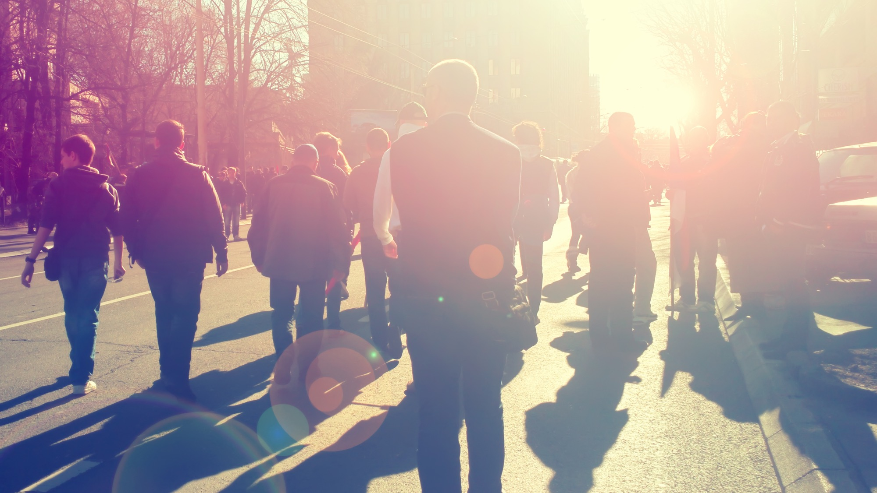
Community Immersion
For changework, local context is essential. And you can’t get that from a simple site visit - and especially not from a microphone or screen. To see how all of the pieces fit together to create lasting change, you have to get out into the community. That's a critical element of Upswell.
Inside & Out Tours
Specially designed in collaboration with community leaders, these half-day tours take you on a journey of social innovation into the heart of the host city's most dynamic neighborhoods where you’ll have the chance to participate like a local rather than just observe as an outsider.
Community Dinners
Upswell Community Dinners offer a chance to experience firsthand how food and mission can go together. Pick from a smorgasbord of options focused on education, health, the arts, economic development, and more. Sit down with strangers, go home with new friends, ideas – and maybe even a solution or two.
27

Slide 28

How We Engage
Leading up to Upswell 2020, we’ll roll up our sleeves to listen and learn with Houston – the people, culture, challenges, and opportunities. We’ll work with changemakers on the ground and across the country to design an experience that matters. And, unlike a typical conference, the three-day gathering in October 2020 is about settling in, not packing up and moving on when it’s over. Here are some of the ways we engage:
Upswell Labs By bringing together diverse groups of community members and changemakers, we aim to gather context and learn about the most pressing community needs.
In-depth Interviews Understanding communities means going deep, so we’ll spend lots of time learning directly with key community leaders.
Prototyping To create a powerful experience in October 2020, we’ll test out new and more effective ways of engaging with each other.
Storytelling We’ll take a multimedia approach to exploring the context and history of Houston and the changemakers who are working to improve their communities.
28

Slide 29








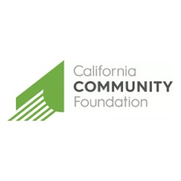


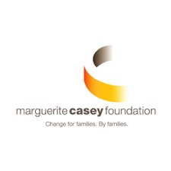




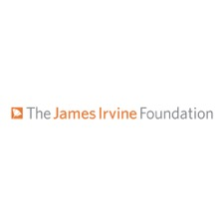

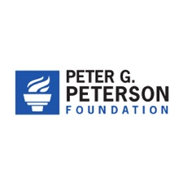



Upswell Partners
29

Slide 30



Accelerate Impact
Ethics &
Accountability
Telling the
Sector Story
Sector
Health
30

Slide 31
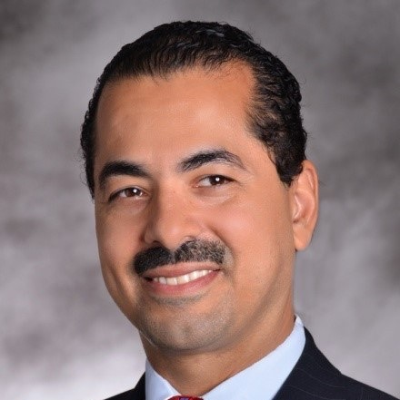
Independent Sector is a true partner with American Express as we work together to strengthen the leadership capacity of next generation leaders. Our organizations appreciate the importance of developing the human capital of the social sector given the significant role it plays in all facets of our lives.
RICHARD A. BROWN
Vice President,
American Express Philanthropy
31

Slide 32
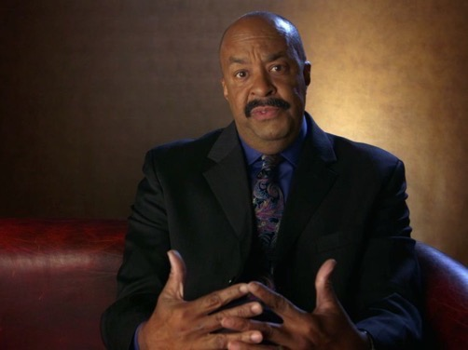
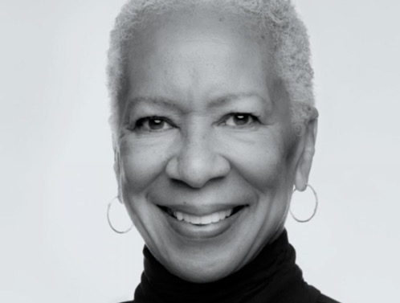
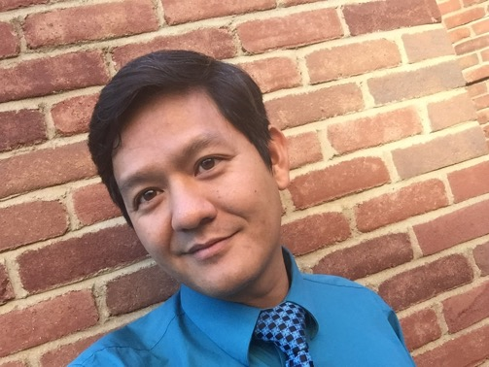

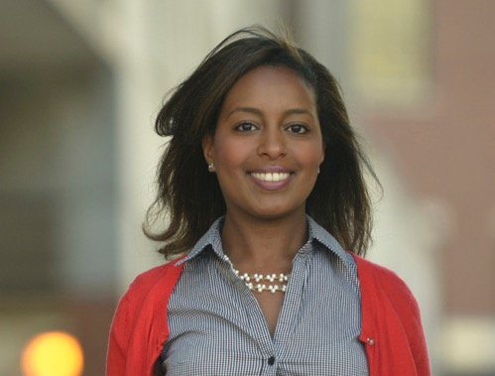
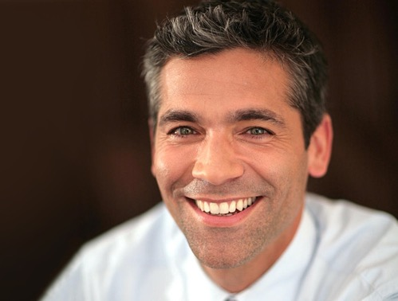
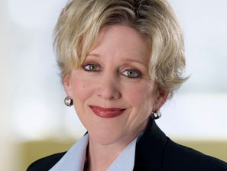

Amplifying Diverse Voices
32

Slide 33

Lead on Policy
Data &
Knowledge
Policy
Agenda
Advocacy
Strategy
33

Slide 34
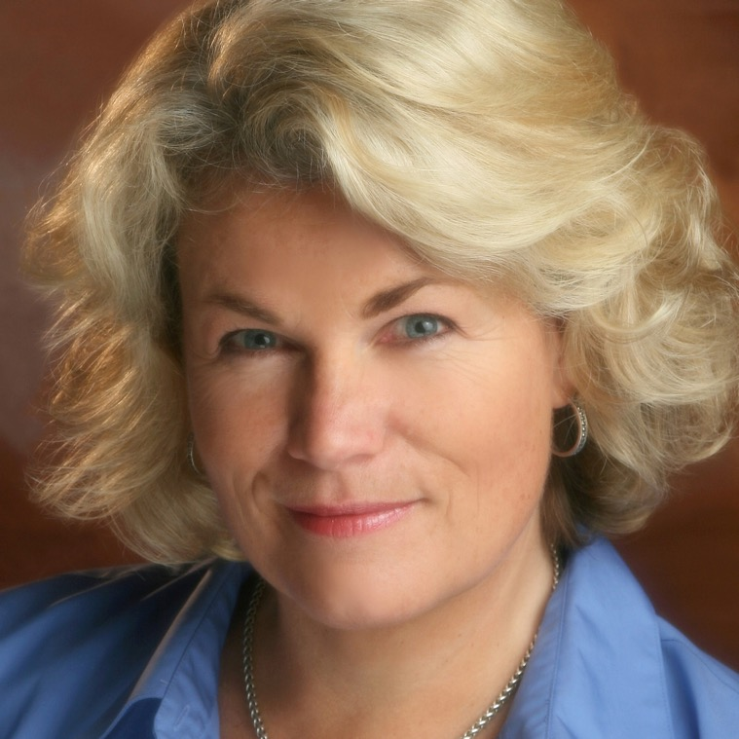
The greatest social change in our country’s history has been as a result of an empowered, active nonprofit sector. There is only one organization—Independent Sector—that sits at the intersection of global trends in technology, organizing, government, nonprofit, business, political systems and social change.
SONYA CAMPION
IS Board Member and President, Campion Foundation
34

Slide 35
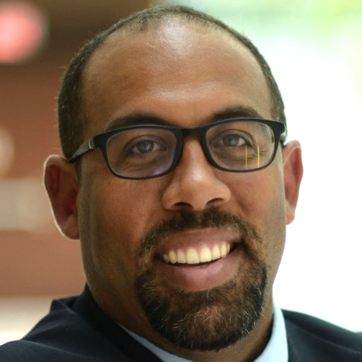
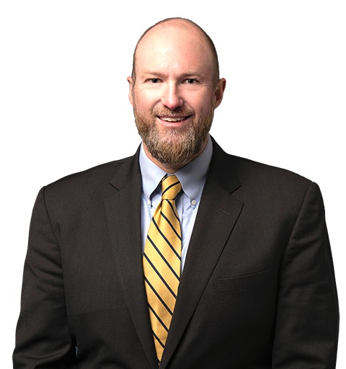
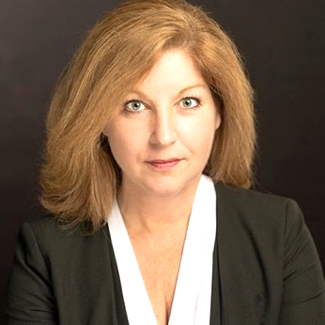
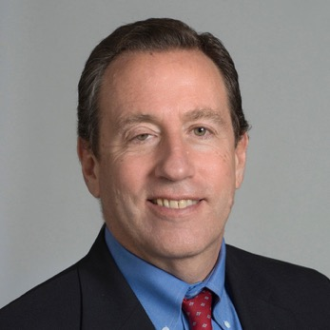
Leveraging External Expertise
JEREMIE GREER
VP of Policy & Research,
Prosperity Now
HAROLD HANCOCK
Partner,
McGuire Woods
CINDY M. LOTT
Senior Lecturer & Academic Program Director, Nonprofit Management Programs, Columbia University’s School of Professional Studies
ALAN ABRAMSON
Professor at the Schar School of Policy & Government, & Director of Nonprofit Management, Philanthropy, & Policy at George Mason University
35

Slide 36
Our Financial Plan
BUILD COMMUNITY
Donec quis tempus libero, sit amet maximus ex. Nullam dapibus interdum tristique. Ut sed dictum augue. Nunc semper efficitur urna, vel mattis nisl tempus feugiat.
ACCELERATE IMPACT
Donec quis tempus libero, sit amet maximus ex. Nullam dapibus interdum tristique. Ut sed dictum augue. Nunc semper efficitur urna, vel mattis nisl tempus feugiat.
LEAD ON POLICY
Donec quis tempus libero, sit amet maximus ex. Nullam dapibus interdum tristique. Ut sed dictum augue. Nunc semper efficitur urna, vel mattis nisl tempus feugiat.
36

Slide 37

Tomorrow, together, we can restore Americans’ trust in civil society and empower the ideal of private action in service of the public good.
37

Slide 38

A Partnership Opportunity
Independent Sector & ###Partner Name###
PLACE-BASED
COMMUNITY
ENGAGEMENT PLATFORM
LEADING AN ENTIRE
SECTOR ACROSS A CRITICAL SOCIAL IMPACT ISSUE
CONTENT
FUEL
SECTOR
TOOLS
Upswell Labs – (2019 Dates & Markets TBD) – Regional Cross Sector Meetings
Upswell (November 2018 Los Angeles) – Fellowships & Content Sessions
In-Person – Upswell Los Angeles 2018, Hosted Session or Track Digital Content -
Strategic Growth Plan – (platform design & development, consulting on tech vision/plan)
Place-Based Collaboration – Detroit, Chicago – hyper-local sector acceleration
Sector Tools – Tech for Good, data, debt-capital, opportunity zones
Nonprofit Empowerment – Fellowships, Affinity program, value-in-kind services,
Opportunity Zone content
Storytelling
Sector Data
Case Studies & Testimonials
Leadership
Diversity Equity
& Inclusion
Tech for
Common Good
Policy Research
38

Slide 39
Questions?
39

Slide 40
Thank You

